Slide 1



ICIS2025
A Cloud Native Approach of Energy Monitoring System Using Microservices Architecture
Corresponding Authors: Nguyen Duc Manh, Bui Quy Duong, Dr. Ta Quang Ngoc

Slide 2
Table of Contents
Introduction
Previous Research
Proposed Architecture
Results and Discussion
Conclusions and Future Research

Slide 3
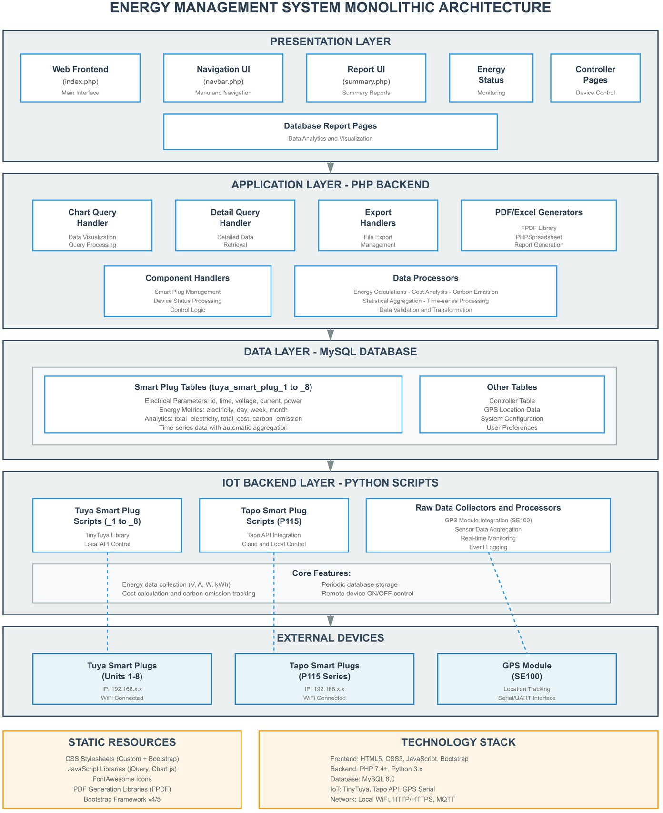
I. Introduction
What is EMS?
Real-time electricity monitoring & optimization system
EMS Responsibilities:
Manage generation, transmission, distribution
Prevent blackouts, reduce costs
Predictive maintenance
Support renewable energy
Challenges of Monolithic EMS:
Data Overload & Poor Scaling
Fixed Resource Limits
Hard to Maintain & Update

Slide 4
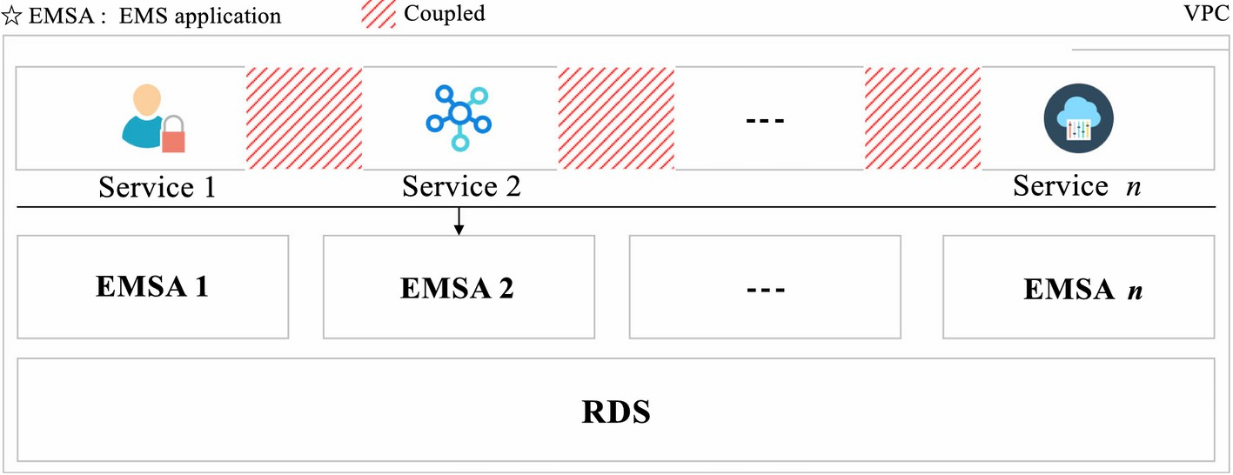
II. Previous Research
Adopted Solution (S-EMS Approach)
Split monolith into individual services
Moved to Virtual Private Cloud (VPC)
Used Cloud RDS instead of local DBs
Remaining Limitations
Still tightly coupled – one service fails → whole app affected
Scaling is coarse-grained – must scale entire app even if one service needs more resources
Cloud benefits not fully realized
* Lyu, Z., Wei, H., Bai, X., & Lian. Microservice-Based Architecture for an Energy Management System. IEEE Systems Journal, 14(4), 5489–5500, 2020.

Slide 5
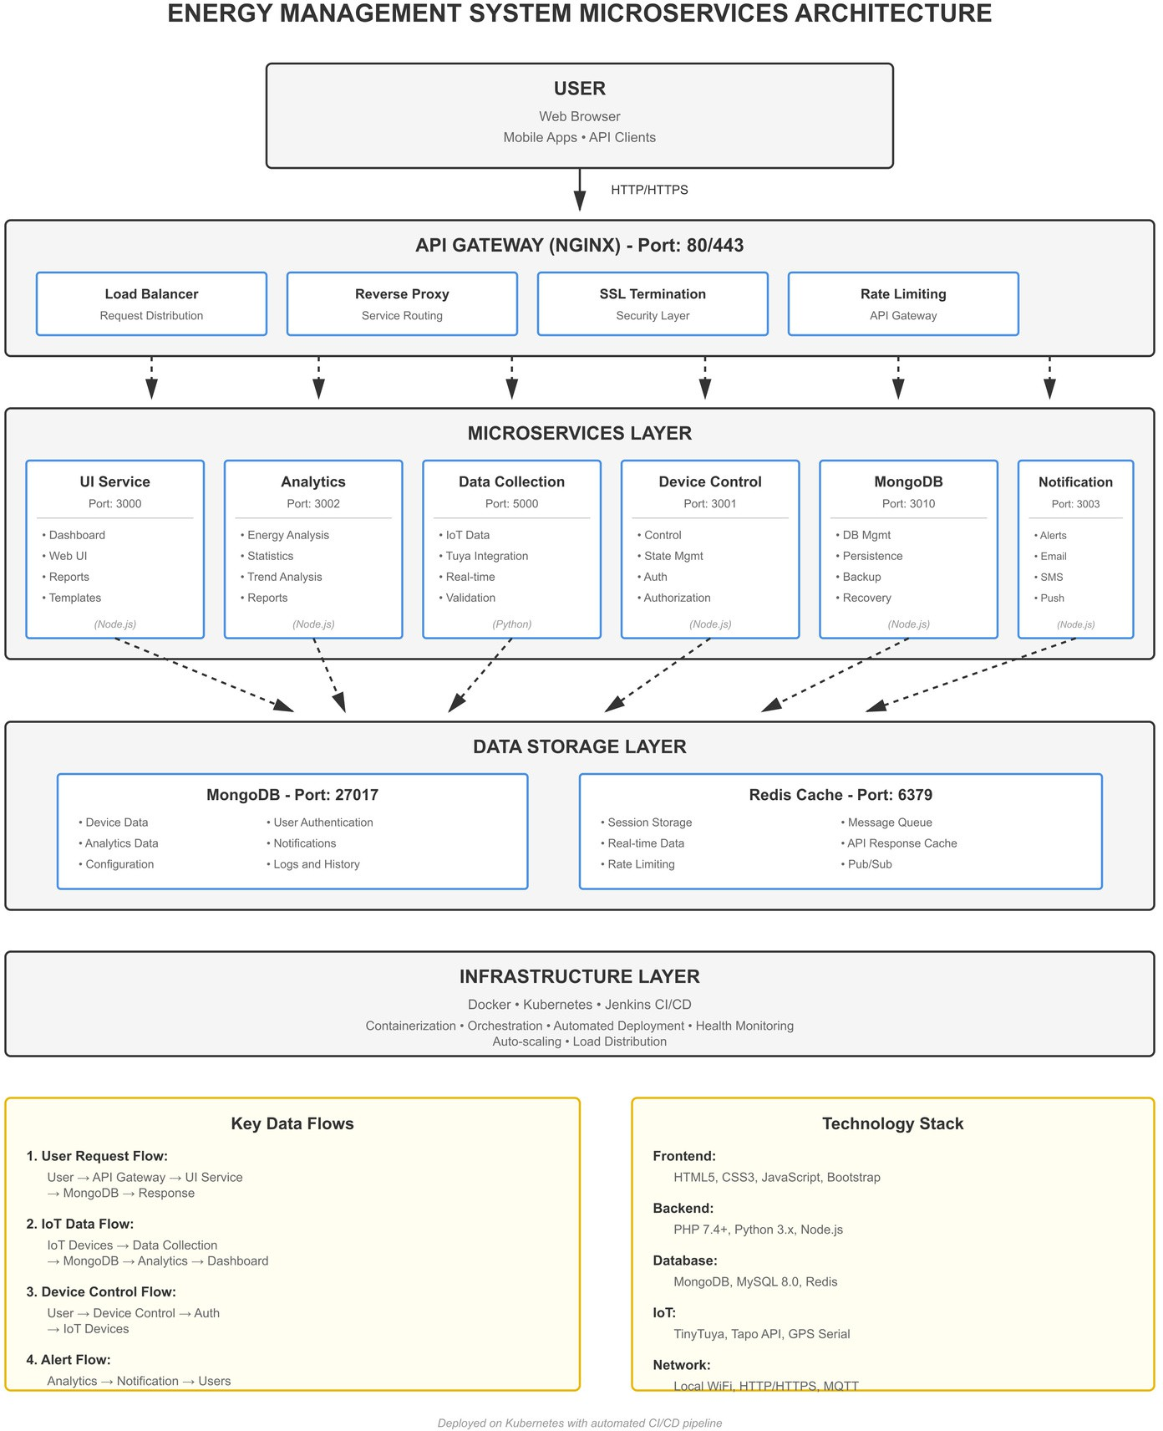
III. Proposed Architecture
Key Technologies
Microservices (Docker) + Kubernetes (DigitalOcean)
API Gateway: NGINX (LB, SSL, Proxy, Rate Limiting)
CI/CD: Jenkins Pipeline
Data: MongoDB (devices/logs), Redis (cache/session)
Backend: Node.js, Python 3.x, PHP 7.4+
Frontend: HTML5, CSS3, JS, Bootstrap
IoT: Tuya, Tapo, GPS Serial | Protocols: HTTP/S, MQTT, Wi-Fi
System Structure
User → API Gateway (port 80/443)
API Gateway routes requests securely to services
Microservices Layer (independent scaling): UI, Analytics, Data Collection, Device Control, MongoDB, Notification
Data Layer: MongoDB + Redis
Infra: Jenkins, K8s, multi-zone HA (k=2)
→ Refer to diagram for full data flow and port mappings

Slide 6







IV. Results and Discussion
1. Transformation Process
We implemented the transformation using a step-by-step approach:
Designing microservices architecture
Dividing functionality into independent
Analyzing the existing system
Identifying key components and relationships between them.
services.
1
2
Containerization
Packaging each service into Docker
containers.
Deploying to cloud platform
Using Digital Ocean with Kubernetes to
manage containers.
7
3
6
4
Building a new database
Transitioning from MySQL to MongoDB with
more flexible schema.
5
Implementing CI/CD
Setting up an automated process with
Jenkins.
Developing API Gateway
Using Nginx as a central access point.

Slide 7
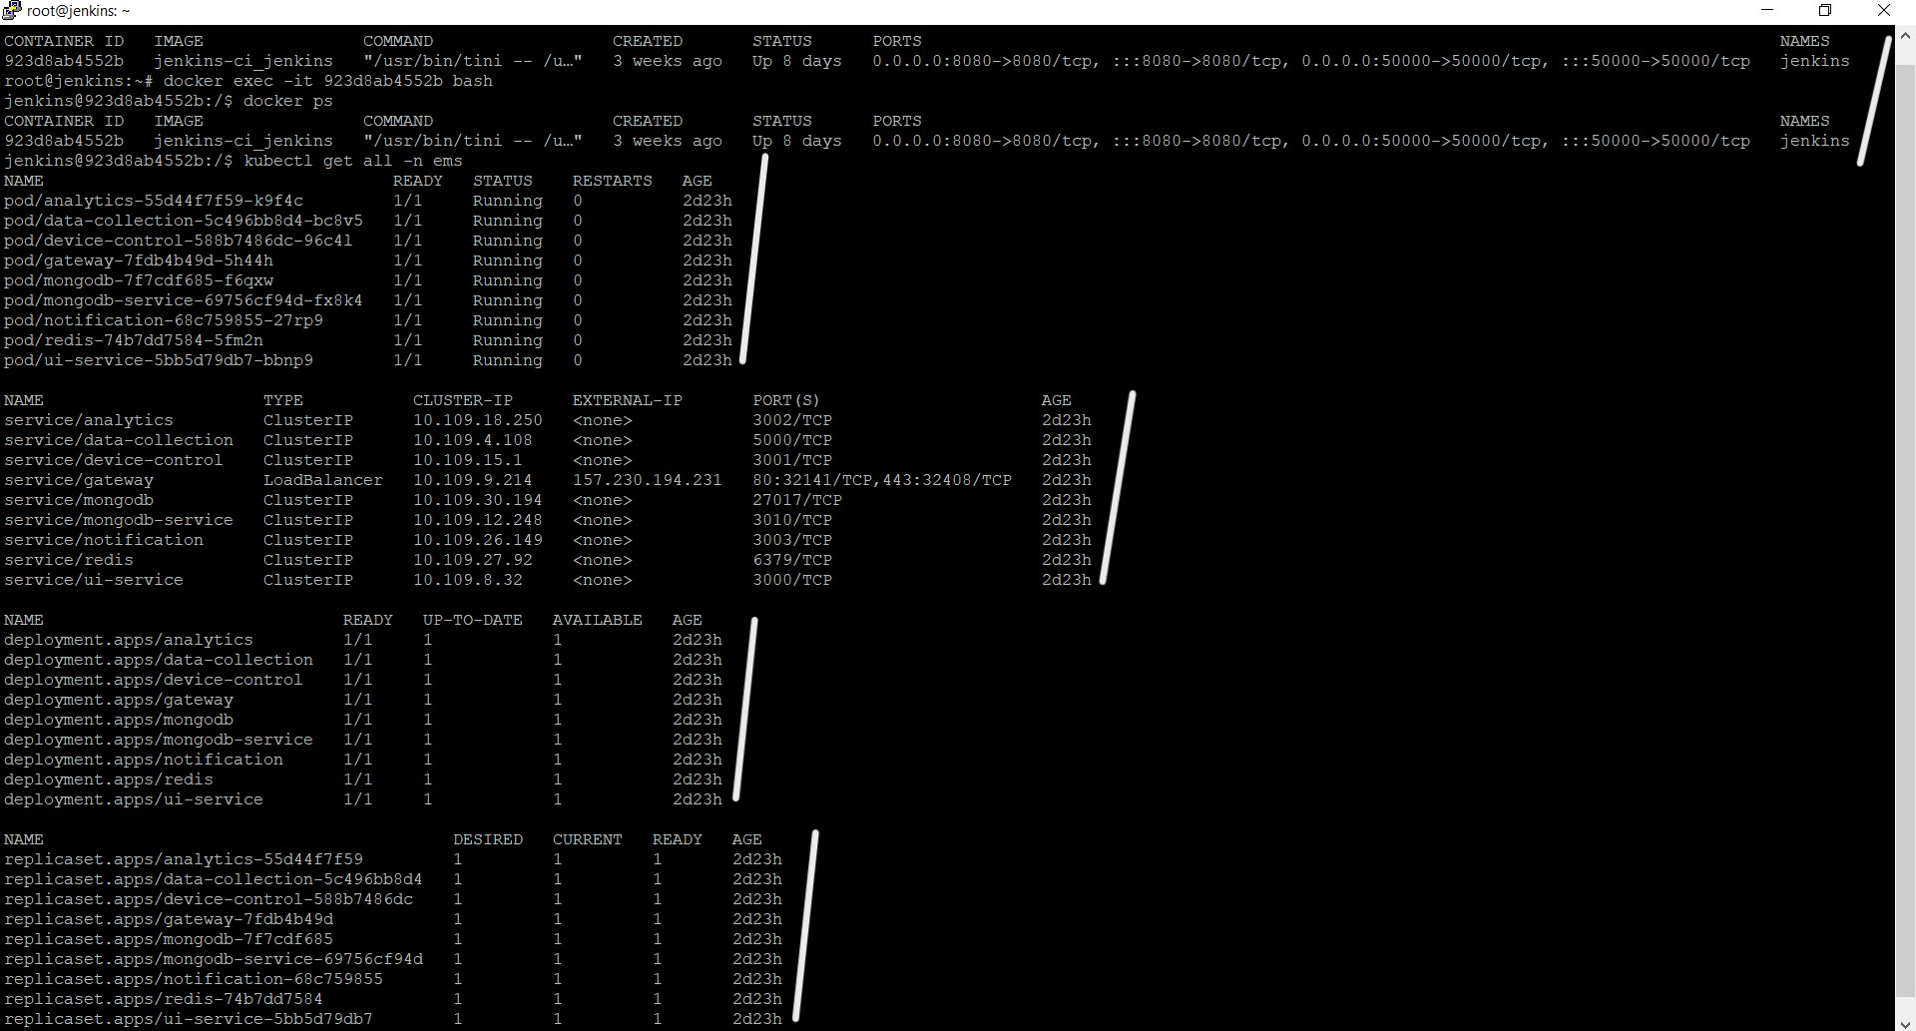
2. Results
A. CLI View from Cloud Server:
Docker container
Pod status
Services
Deployments
ReplicaSets

Slide 8
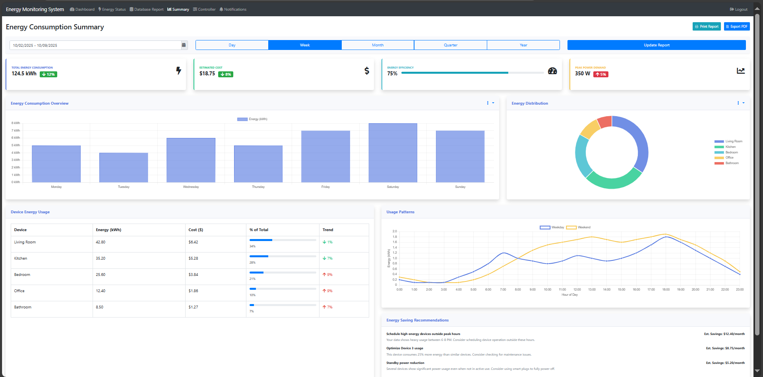
B. Energy Consumption Summary Dashboard:

Slide 9
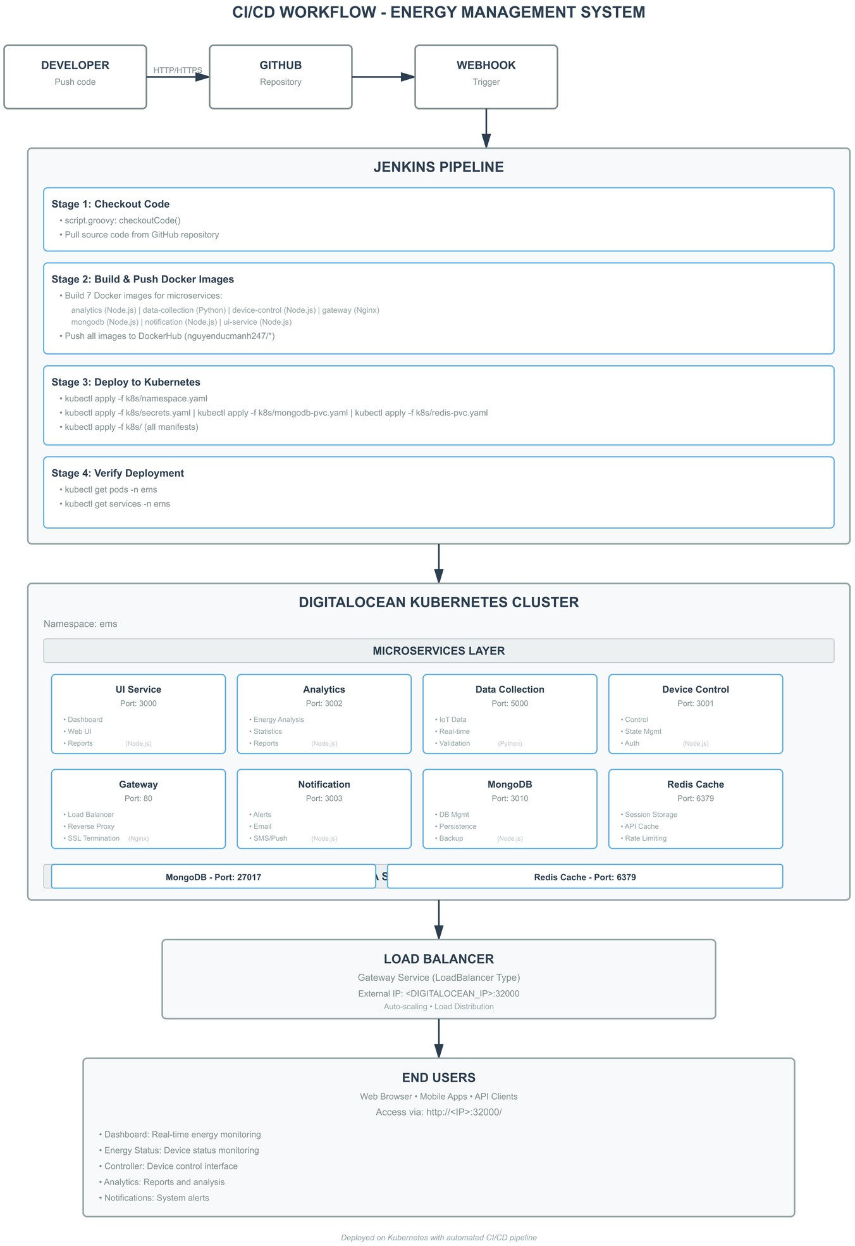
C. General Overview – CI/CD Workflow:
A.Step:
Checkout
Dev pushes to GitHub → Jenkins triggered via webhook
Build & Push
Jenkins builds Docker images → Pushes to DockerHub 3.Deploy
Apply K8s YAMLs → Services deployed to cluster 4.Verify
Jenkins checks pod & service status (kubectl get) B.Environment:
Platform: Digital Ocean Kubernetes Cluster
Microservices: UI, Analytics, Gateway, Data Collection, Device Control, Notification, MongoDB, Redis
Gateway Port: 80 | MongoDB: 27017 | Redis: 6379
User Access: Via Web, Mobile, or API
→ Load Balanced access at <IP>:32000

Slide 10
V. Conclusions and Future Research
Achievements:
Solved 3 key problems: Data overload, Poor scalability, Maintenance issues
Established a scalable cloud-native microservices foundation
Future Work:
Real Device Integration – Connect to actual IoT devices
AI Algorithms – Predict usage patterns, optimize energy
Advanced Analytics – Big data tools, deeper insights
UX Enhancements – Mobile support, customizable dashboards
→ Cloud-native + Microservices = Sustainable growth platform for future EMS

Slide 11


